Slide 1
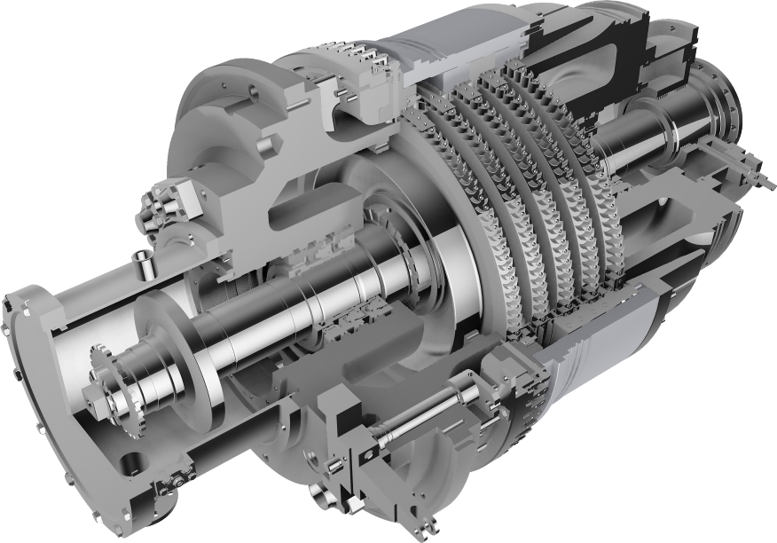
Energy saving
turboexpanders
(UTDU)
Notes:
Титул

Slide 2
ENERGY SAVING TURBOEXPANDERS
“Turbogaz” PJSC (All-Union scientific-manufacturing association (VNPО) “Soyuzturbogaz”) was established in 1975 by the order of the Ministry of Gas Industry of the USSR, as a principal company for development and implementation of turboexpanders on sites of oil, gas and power industries. Before 1991 the company belonged to “Gazprom” group of companies. In 1994 “Soyuzturbogaz” became “Turbogaz” JSC.
Today “Turbogaz” public joint stock company is a strong scientific-manufacturing company incorporating the design department, pilot plant and testing facilities. Total amount of the employees is circa 400 specialists.
Activities of our company cover all engineering stages: analysis of
gas treatment and processing plants process flows, development of feasibility study and proposals, development of the design documents, manufacturing and supply of ready Goods, including installation supervision and commissioning, training of the maintenance staff, guarantee and post guarantee servicing. ISO 9001-2000 international quality management system and ISO 14001:200 environmental management standard are adopted and successfully used in the company.
Core business of “Turbogaz” PJSC is development and implementation of low temperature turbo-refrigerating expanders (NTDA) in conditions of processing and treatment of natural and associated oil gas as well as energy-saving turboexpanders (UTDU)
Notes:
2
Титул

Slide 3
ENERGY SAVING TURBOEXPANDERS
UTDU are intended for electric power generation by saving the natural gas excessive pressure energy at gas reduction points– gas distribution stations (GDS), gas distribution points (GDP) of the gas transportation system, heat power plants, metallurgical, chemical plants and at other large gas consumers.
Today “Turbogaz” PJSC manufacturers in-house developed UTDU of different power: 300 kW, 1MW, 2.5MW; 4MW; 5MW; 6MW; 8MW; for inlet gas pressure up to 6.3 MPa and gas flow of 0.05-6 mln. nm^{З}/24 h.
Packaged UTDU are equipped with modern automatic control and protection systems, which provide plants operation safety.
Combined energy-saving power plants (UDEU) are intended for cold generation in the low temperature separation system with the simultaneous electric energy generation. “Turbogaz” PJSC developed and manufacturers UDEU with productive efficiency from 3.0 to 5.5 mln. m^{З}/24 h with gas pressure up to 5.5 MPa.
Notes:
Титул

Slide 4
Why it is profitable to use turboexpanders
at gas distribution points
Gas in в main pipelines flows at high pressure to decrease loss by friction. Gas in industry and in household is used at very low pressure. The compressed gas energy potential, accumulated in the high pressure pipeline, is irrevocably lost with pressure decrease at gas distribution stations.
If pressure is reduced with the help of the turboexpander, this energy potential can be transformed into the electric power

Slide 5
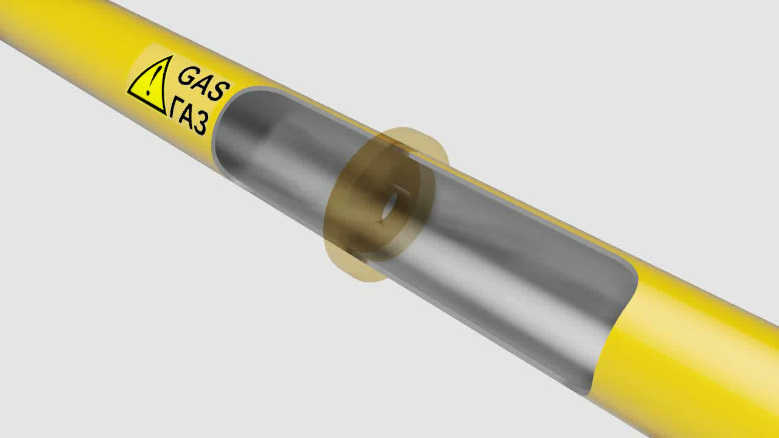
Pressure drop in main gas pipeline
with the use of throttling orifice

Slide 6
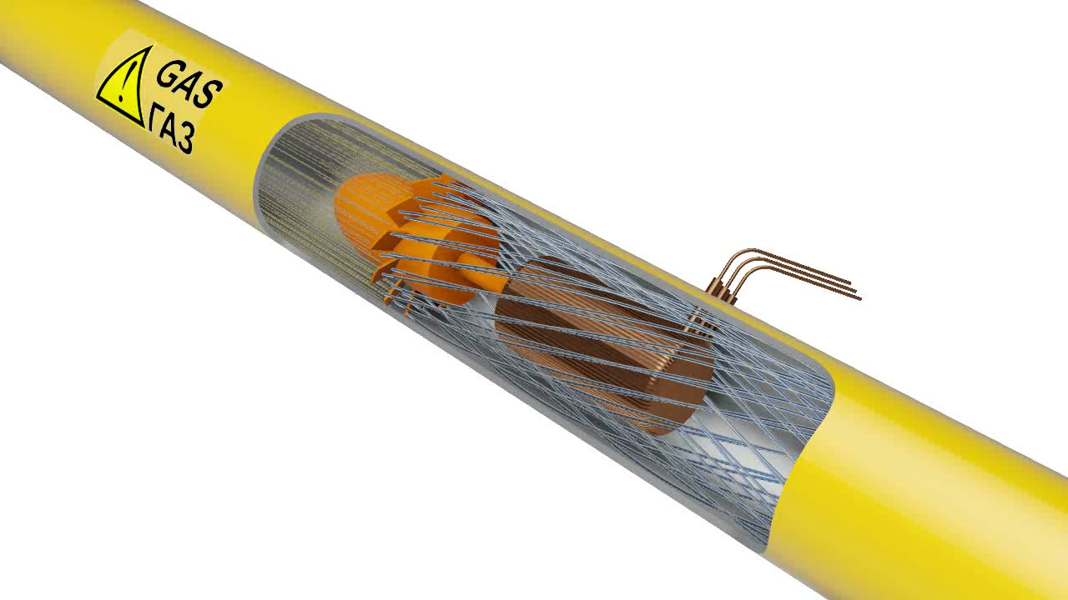
Pressure drop in main gas pipeline
with the use of turboexpander

Slide 7

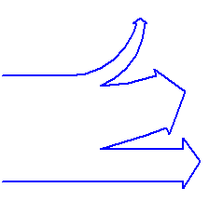
Typical gas distribution station (GDS)
Loss 100%
Flow potential at GDS inlet
Flow potential at GDS outlet
GDS with turboexpander
Loss 20%
Transformation into electric power 80%
Flow potential at GDS inlet
Flow potential at GDS outlet

Slide 8
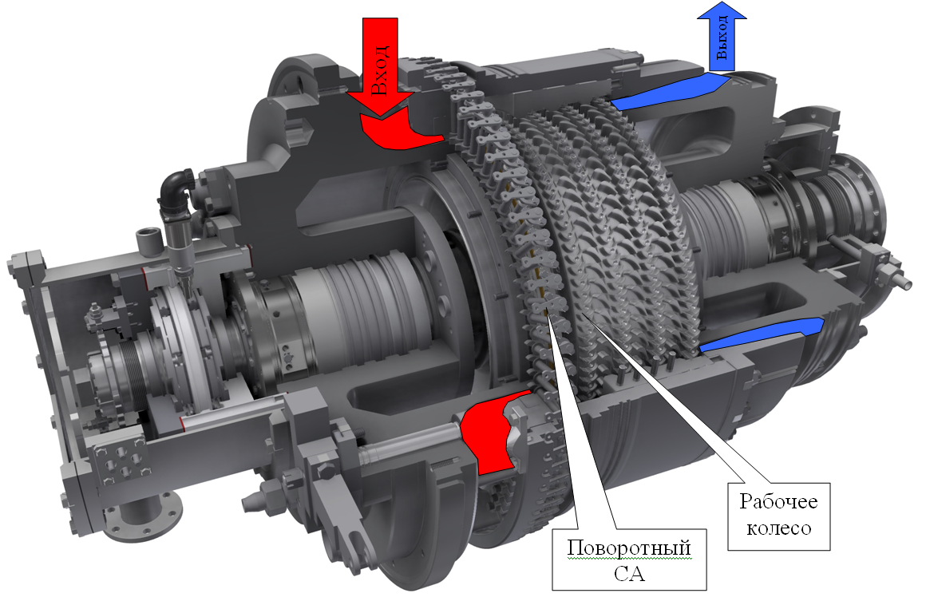
Turboexpander overall view
Inlet
Outlet
Impeller
Rotating
set of nozzles

Slide 9
Turboexpanders.
Purpose and advantages
Main advantages of turboexpanders (TDU) compared with heat and power stations:
- cost of the potential power generated by UTDU is approximately two times less than cost of generation of the similar power by conventional gas or steam turbines
- heat input for 1 kW of the generated power is 2-3 times less than heat expenses of steam- and gas-turbine plants;
- gas saving (approximately) up to 60%
- total absence of solid discharges, nitrogen oxides and sulfur discharge into the atmosphere and industrial water discharge
- effective efficiency factor is 0.7 - 0.8

Slide 10
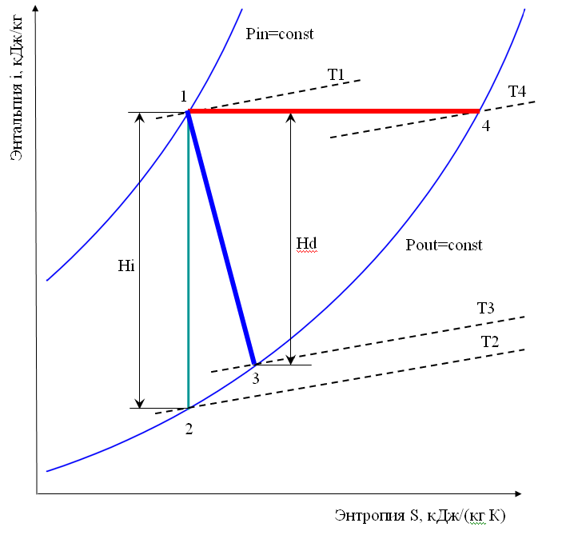
Thermodynamic gas expansion
«1 – 2» - gas expansion process without considering loss (isoentropic);
«1 – 3» - gas expansion process in turboexpander;
«1 – 4» - Joule-Thomson effect in valve*.
Hi – isoentropic heat drop
Hd – actual heat drop in turboexpander
Turboexpander efficiency factor:
Enthalpy i, kJ/kg
(Power)
Turboexpander useful power:
T1>T4>T3>T2
Entropy S, kJ/(kgK)
where G is gas mass flow
(Heat)

Slide 11
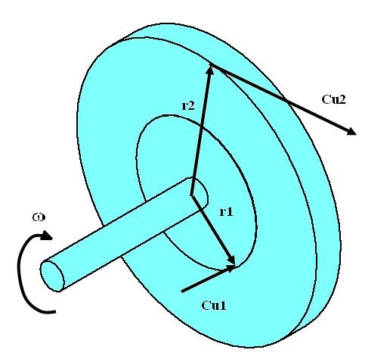
EULER'S FORMULA : impeller performance
Energy equation:
Expander power :
N = G · (r2 ·Cu2 – r1 ·Cu1) · ω
where
G – gas mass flow through impeller;
r – radius;
Cu2, Cu1– tangential component of inlet and outlet speed;
ω – shaft angular frequency of revolution.

Slide 12
UTDU PROCESS FLOW DIAGRAM AT GDS
Gas from pipeline
Gas distribution station - GDS
Gas to consumers
1 Turboexpander plant
1.1 Turboexpander
1.2 Generator
2. Heat-exchanger equipment
2.1 Heat-exchanger (hot-water boiler)
2.2 After burning device
2.3 “Gas-water” heater
3. Shut off metering valve unit
4. Bypass valve unit
Heat carrier discharge
Heat carrier supply
Notes:
Титул

Slide 13
UTDU PROCESS FLOW DIAGRAM at GDP (HEAT POWER PLANT)
Gas from pipeline
Gas to consumers
Gas distribution point - GDP
1 Turboexpander with power of 4MW
1.1 Turboexpander
1.2 Reducing gear
1.3 Generator 4MW
2. “Gas-water” heater
3. Shut off metering valve unit
4. Bypass valve unit
Heat carrier discharge
Heat carrier supply

Slide 14
PROCESS FLOW DIAGRAM OF UTDU TO GDS
BY COGENERATION CYCLE
Gas from pipeline
Gas to consumers
Gas distribution station – GDS
1 Turboexpander power plant
1.1 Turboexpander
1.2 Generator
2. Gas turbine power plant
2.1 Gas turbine engine
2.2 Generator
3. Heat exchanging equipment
3.1 Energy saving heat exchanger (exhaust-heat water boiler)
3.2 After burning device
3.3 “Gas-water” heater
4. Reduction station of fuel and startup gas
5. Shut off metering valve unit
6. Bypass valve unit
Heat carrier discharge
Heat carrier supply
Heat carrier supply
Q=130 t/h
Q_{START} = 13320 nm³/h
P_{START} = 1.7 MPa
P_{FUEL} = 2.1 MPa
Q_{FUEL}=1450 nm³/h
Notes:
Титул

Slide 15
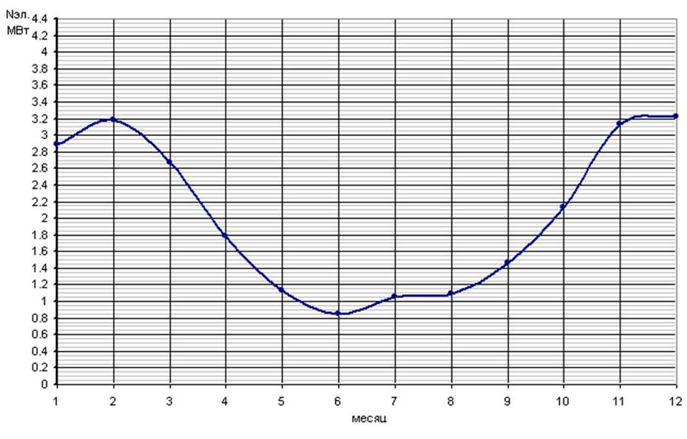
TDA ELECTRIC GENERATOR POWER,
AVERAGE BY MONTHS OF YEAR
Nel.
MW
MONTH
Notes:
Титул

Slide 16
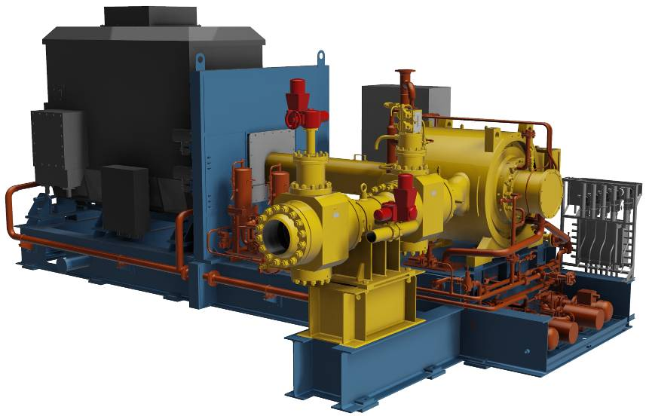
Expander-generator plant
with power of 4 MW
Notes:
16
Титул

Slide 17
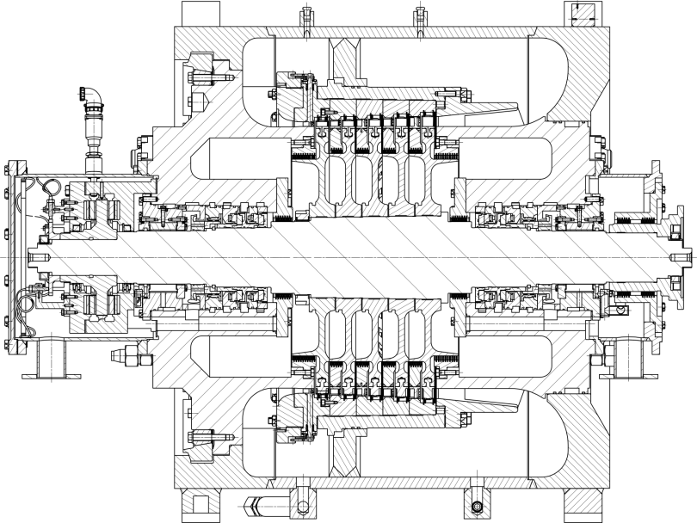
Turboexpander of expander-generator plant
with power of 4 MW
Notes:
17
Титул

Slide 18
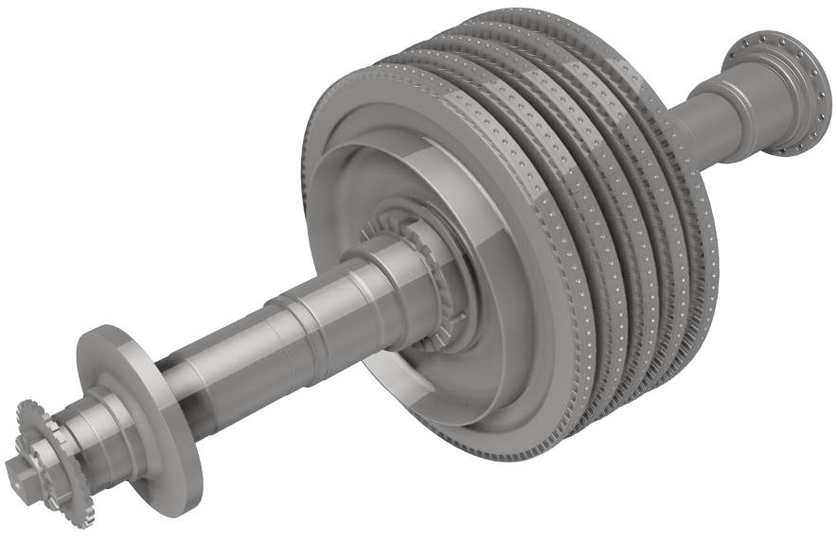
Rotor of expander-generator plant
with power of 4 MW
Notes:
18
Титул

Slide 19

Changeable air-gas channel
of expander-generator plant with power of 4 MW
Notes:
19
Титул

Slide 20
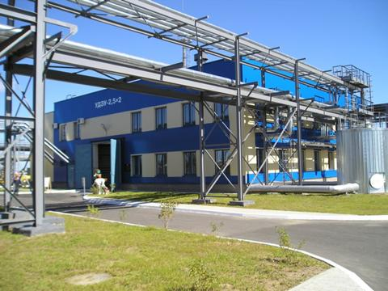
UDEU-2500, Minsk city, since 2005

Slide 21
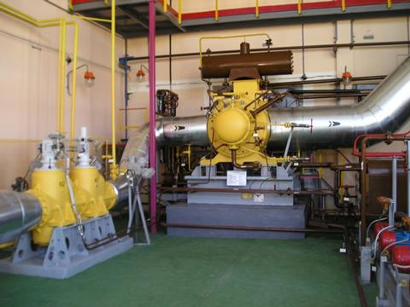
UDEU-2500, Minsk city, since 2005

Slide 22
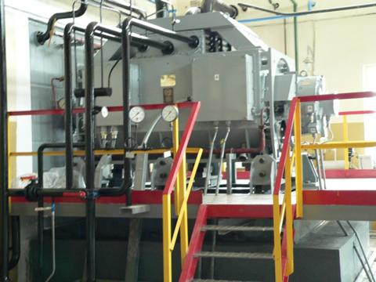
Generator UDEU-2500

Slide 23

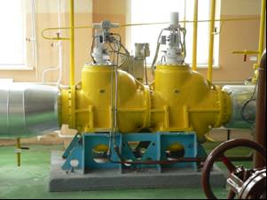
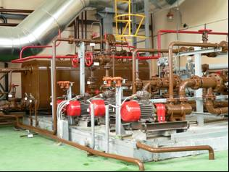
Two energy-saving plants UDEU 2500 UKhL4
With power of 2500 kW at GDP of Minsk heat power plant-4
Republic of Belarus since 2005
Notes:
Титул

Slide 24
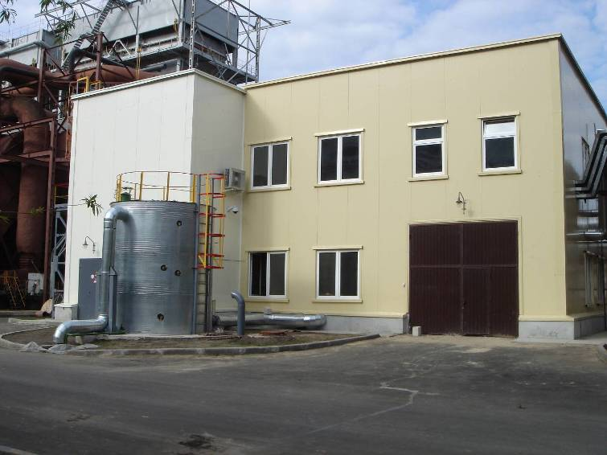
UTDU-4000, Gomel town, since 2008

Slide 25
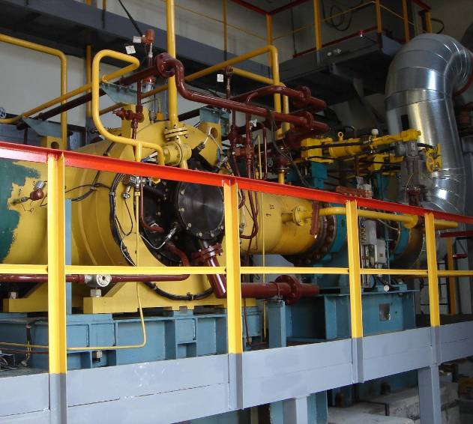
UTDU-4000, Gomel town, since 2008

Slide 26
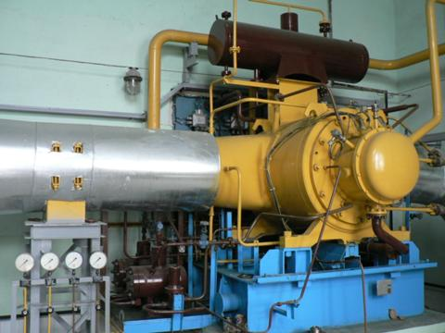
UDEU-2500, Novolukoml town, since 2006

Slide 27
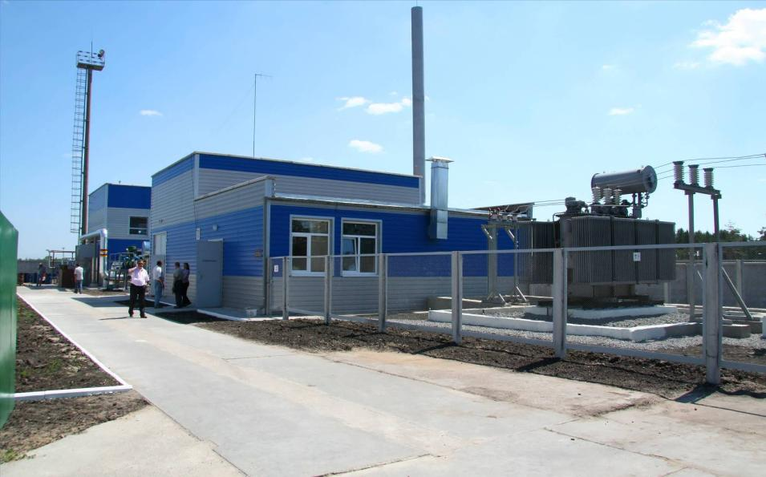
UTDU-4000, GDS Severodonetsk city, since 2008

Slide 28
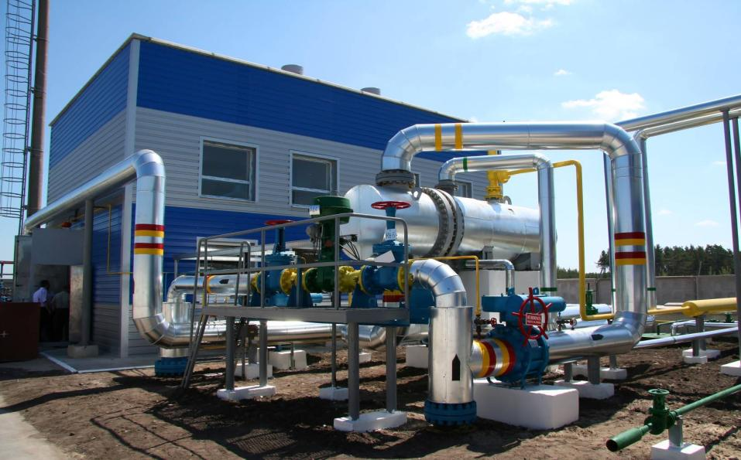
UTDU-4000, GDS Severodonetsk city, since 2008

Slide 29
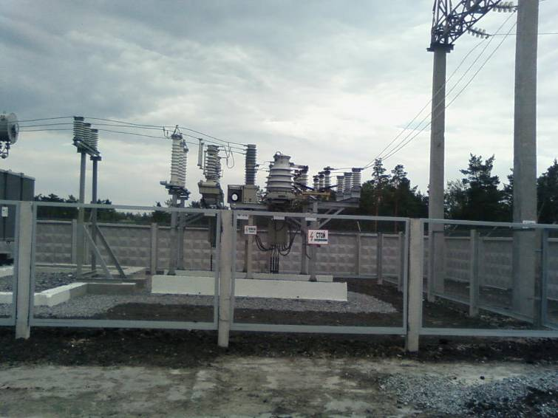
UTDU-4000, GDS Severodonetsk city, since 2008

Slide 30
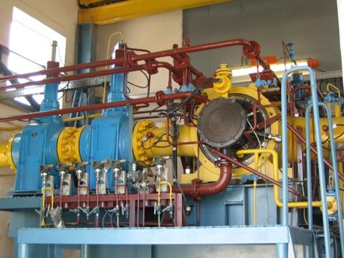
UTDU-4000, GDS Severodonetsk city, since 2008

Slide 31
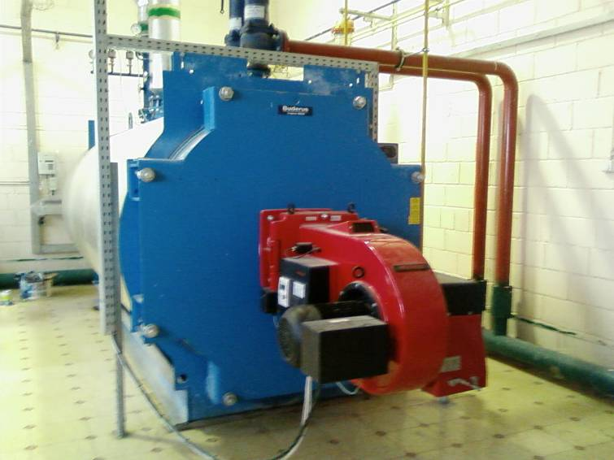
UTDU-4000, GDS Severodonetsk city, since 2008

Slide 32
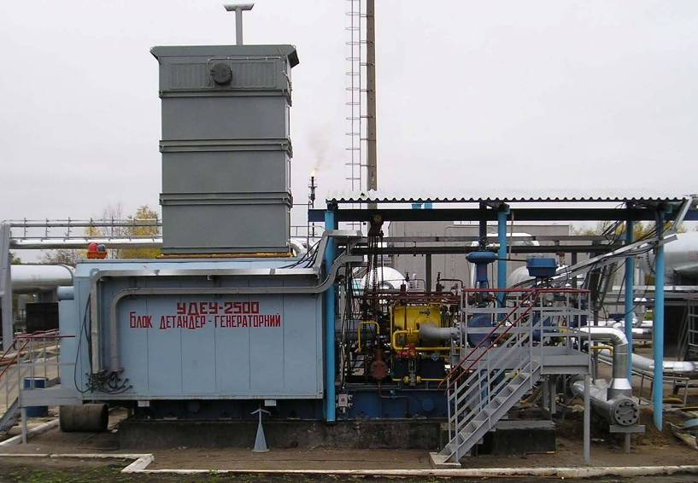
UDEU-2500 at «SOLOKHA» GAS STATION SINCE 2009
Notes:
Титул

Slide 33
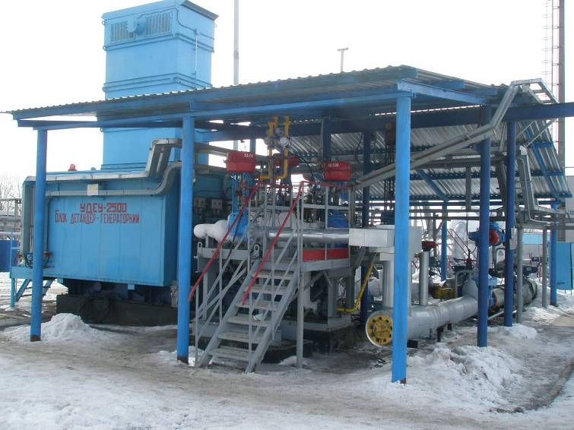
Combined plant UDEU-2500-UKhL2
AT «SOLOKHA» GAS STATION
Notes:
Титул

Slide 34
ENERGY-SAVING TURBOEXPANDERS
Object name | Object year of implemen-tation | Average life, hour | Country | Q-ty of supplied plants, pcs | Power, kW | Q, mln m³/24 h | Р_{IN}, MPa | Р_{OUT}, MPa | DN _{IN}, mm | DN _{OUT}, mm | Reducer availability
High pressure UTDU
UMG “Kharkovtransgaz” Subsidiary Company of “Ukrtransgaz” GDS-7 of Dnepropetrovsk LP UMG | 1991 |  | Ukraine | 1 | 2500 | 4.5 | 2.15 | 1.0 | 300 | 400 | no
GDS, Severodonetsk city | 2008 | 10729 | Ukraine | 1 | 4000 | 4.2-5.9 | 3.27÷4.5 | 1.1÷1.4 | 300 | 400 | yes
GDS, Zaporozhye city | 2013 |  | Ukraine | 1 | 4000 | 4.2-5.9 | 3.27÷4.5 | 1.1÷1.4 | 300 | 400 | yes
GDS, Stariy Oskol city | 2013 |  | Russian Federation | 1 | 4000 | 3.6÷3.84 | 4.1÷4.6 | 1.3÷1.4 | 300 | 500 | no
GPU “Poltavagazdobycha”, “Solokha” gas station | 2009 | 10411 | Ukraine | 1 | 2500 | 3.0÷5.5 | 5.0÷5.5 | 2.7÷3.5 | 200 | 300 | no
Low pressure UTDU
Minsk heat power plant-4 | 2005 | 18265 | Belarus | 2 | 2500 | 2.4 | 0.9 | 0.3 | 400 | 700 | no
GDP, Novolukoml town | 2006 | 18170 | Belarus | 1 | 2500 | 2.4 | 0.9 | 0.3 | 400 | 700 | no
Gomel heat power plant-2 | 2008 | 6639 | Belarus | 1 | 4000 | 2.6 | 1.2 | 0.2 | 500 | 800 | yes
Notes:
Титул

Slide 35
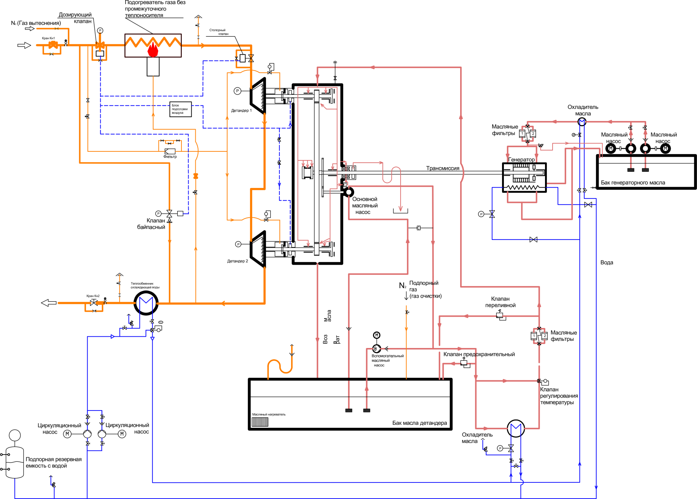
UTDU-4000 INTEGRATED FORM,
DRY GAS SEALS
Gas heater without the intermediary heat carrier
N2 (Displacement gas)
Metering valve
Valve Kn1
Shut off valve
air-preparation unit
Expander 1
Oil
cooler
Oil
filters
Oil
pump
Oil
pump
filter
Transmission
Generator
Generator oil tank
Main oil pump
Bypass valve
Expander 2
Water
Cooling water heat exchanger
Supporting gas
(cleaning gas)
Valve Kn2
Overload relief valve
Oil
return
Oil
filters
Auxiliary oil pump
Safety valve
Temperature control
valve
Oil heater
Expander oil tank
Circulating
Circulating
pump
pump
Oil
cooler
Supporting reserve tank with water
Notes:
Титул

Slide 36
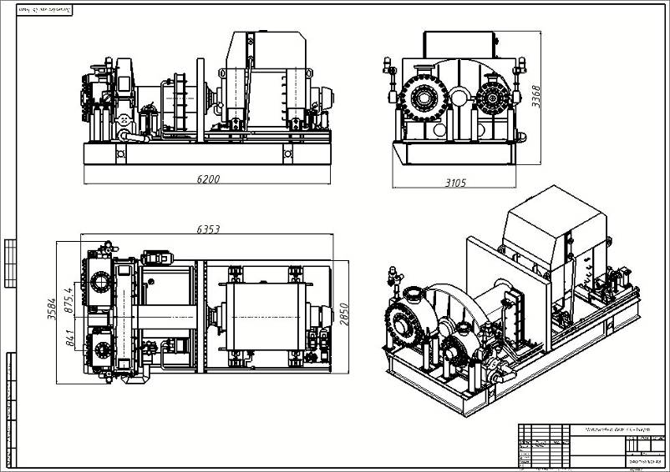
UTDU-4000 INTEGRATED FORM,
DRY GAS SEALS (DRAWING)
Notes:
Титул

Slide 37
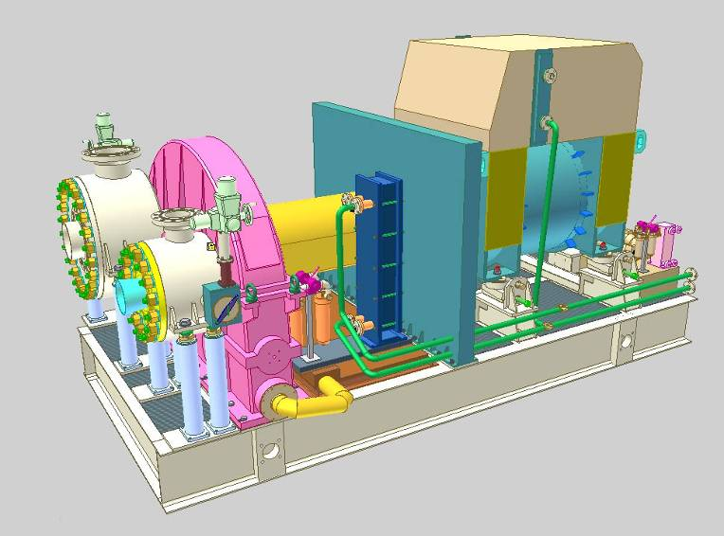
UTDU-4000 INTEGRATED FORM,
DRY GAS SEALS
Notes:
Титул

Slide 38
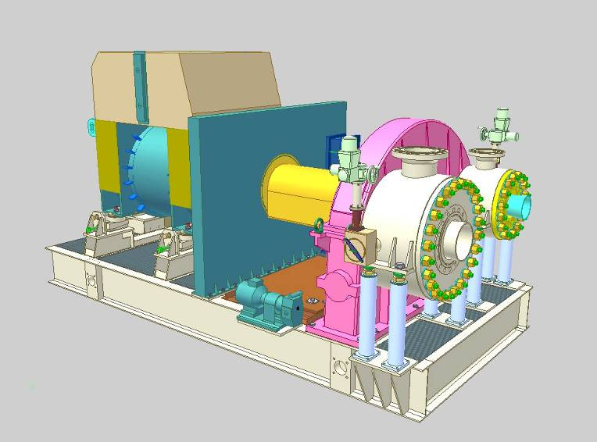
UTDU-4000 INTEGRATED FORM,
DRY GAS SEALS
Notes:
Титул

Slide 39
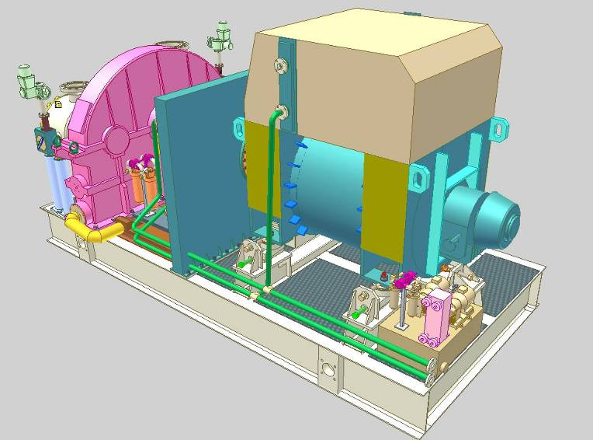
UTDU-4000 INTEGRATED FORM,
DRY GAS SEALS
Notes:
Титул

Slide 40
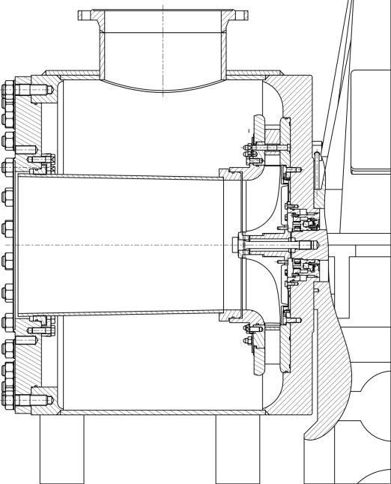
UTDU-4000 INTEGRATED FORM,
DRY GAS SEALS
Notes:
Титул

Slide 41
ENERGY-SAVING TURBOEXPANDER PLANTS
STANDARD SCOPE OF SUPPLY
No. | Description | Supplier, manufacturer
1 | Expander-generator plant consisting of:
1.1 | 2-stage radial-axial expander | “Turbogaz” PJSC
1.2 | Reducer, N=1700 kW, p=26000/17000/1500 rpm. | “BHS”, Germany
1.3 | Low rotating transmission, p=1500 rpm | “BHS”, Germany
1.4 | Synchronous generator LSA 52.2 XL80 / 4р 1875 kVA 6300 V 50Hz IP 54 with power of 1.5 MW | “Leroy Somer”, France
1.5 | Generator and reducer lubrication system | “Turbogaz” PJSC
1.6 | “Oil-water” heat exchanger of reducer oil cooling FP-08-41-1-NH | “FUNKE”, Germany
1.7 | Dry gas seals (double set) | “Burgmann”, Germany
1.8 | Rack of control and adjustment tools of dry gas seals operation | “Burgmann”, Germany
1.9 | Block-box with fire-extinguishing, * ventilation, heating system (for generator) | “Turbogaz” PJSC
Notes:
Титул

Slide 42
ENERGY-SAVING TURBOEXPANDER PLANTS
STANDARD SCOPE OF SUPPLY
No. | Description | Supplier, manufacturer
2 | Shut off valve | “Adams”, Germany
3 | Metering valve | “Adams”, Germany
4 | Bypass valve | “Adams”, Germany
5 | Air-preparation unit for dry gas seals and pneumatically operated valves
6 | Block-box of electrical equipment and automated monitoring and control system including
6.1 | Automated monitoring and control system of expander-generator plant , including control cabinet, auxiliaries cabinet, operator automated workstation, uninterruptable power supply | “Promavtomatika” KB, LLC
6.2 | Switchgear and control gear | “Zaporozhye Plant of High – Voltage Equipment” (ZZVA)
6.3 | System of synchronization to line
6.4 | Auxiliary transformer 120 kW
6.5 | Electrical distribution panel 0.4 kV
6.6 | Block-box with fire-extinguishing, heating, ventilation, air conditioning system | “Turbogaz” PJSC
Notes:
Титул

Slide 43
ENERGY-SAVING TURBOEXPANDER PLANTS
STANDARD SCOPE OF SUPPLY
No. | Description | Supplier, manufacturer
7 | Block-modular water-heating boiler plant BMVKU-2,0G(E) with power of 1,26 MW | Monastyrishche
8 | Gas heating heat exchanger at expander-generator plant inlet 600TP-6,3-M 1 /20G -5,2 - T-2-Y-I | Mashzavod, Chernovtsy
9 | Heat exchanger of water cooling of oil cooling system at outlet from expander-generator plant 400TP-6,3-М 1 /20G-1,75-Т-2-Y-I | Mashzavod, Chernovtsy
10 | Treated water for boiler, natural gas heating system at inlet and oil cooling system | “Turbogaz” PJSC
11 | Se of special tools of expander-generator plant
12 | Set of spare parts for expander-generator plant for two years of operation | “Turbogaz” PJSC
13 | Design and operation documents | “Turbogaz” PJSC
Notes:
Титул

Slide 44
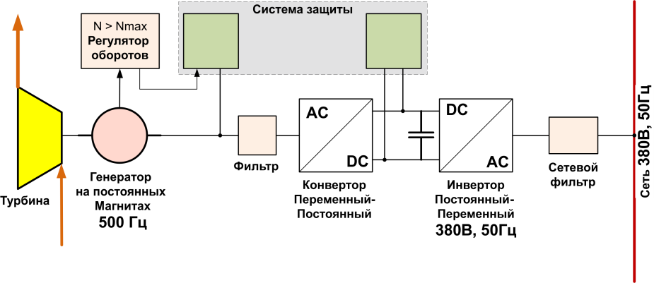
Expander-generator plant
with power of 300 kW
Protection system
Speed governor
Mains 380V, 50 Hz
Permanent magnets generator 500 Hz
Filter
Power
filter
AC/DC
converter
AC/DC
inverter
380V, 50Hz
Turbine
Notes:
Титул

Slide 45
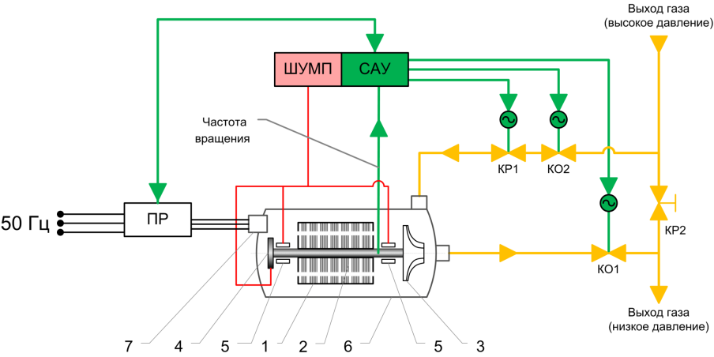
Expander-generator plant
with power of 300 kW
Gas outlet
(high pressure)
MBCC
ACS
Rotation
frequency
Frequency and voltage converter
50 Hz
Gas outlet
(low pressure)
Notes:
Титул

Slide 46
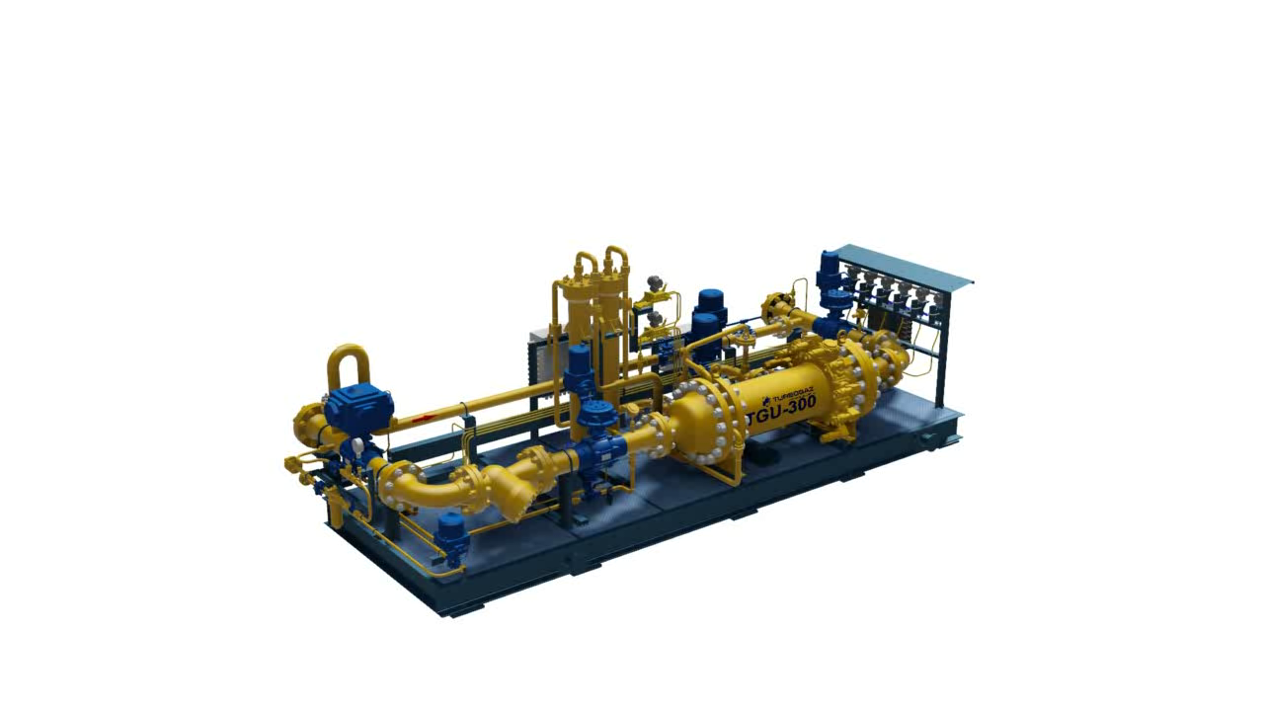
Expander-generator plant
with power of 300 kW
Notes:
Титул

Slide 47
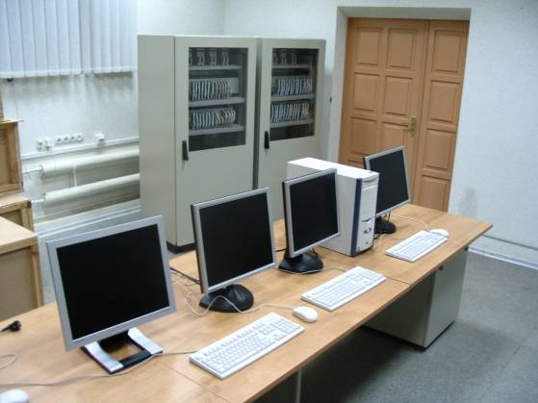
UTDU ACS
The important component of UTDU is the automatic control system (ACS), which is the main logic and control element of the plant.
ACS provides remote automated control of preparation and start up of the plant, control and regulation of parameters in the process of operation, standard and emergency stop of the plant, display of the controlled parameters on monitor.
Automated workstation of UDEU-2500 ACS
Notes:
Титул

Slide 48
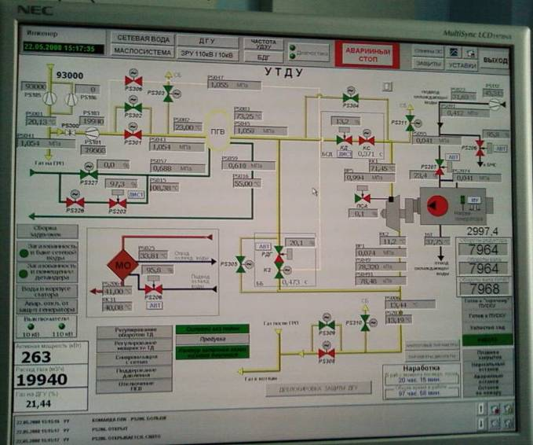
UTDU ACS
STANDARD MEMO PAGE OF OPERATOR AUTOMATED WORKSTATION

Slide 49
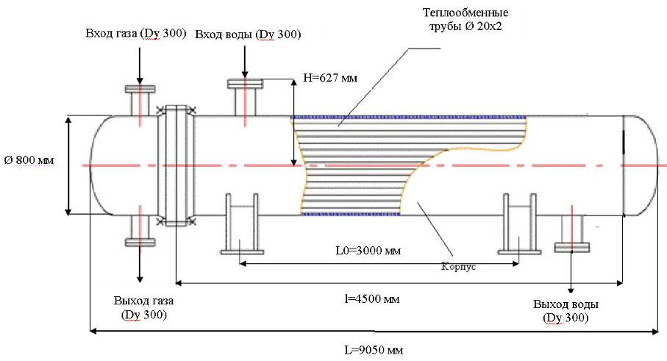
Gas-water heat exchanger
for gas heating at UTDU inlet (800 ТU-6,3-М1-4,5-2К)
Heat exchanger pipes Ø20x2
Gas inlet (DN 300)
Water inlet (DN 300)
H = 627 mm
Ø 800 mm
L0 = 3000 mm
Casing
Gas outlet
(DN 300)
L = 4500 mm
Water outlet
(DN 300)
L = 9050 mm
Notes:
Титул

Slide 50
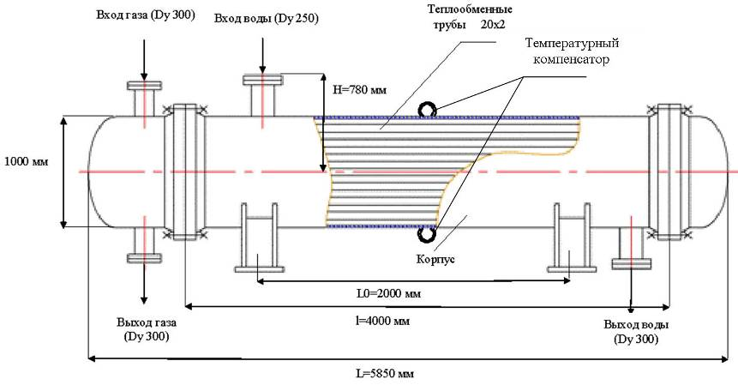
Gas-water energy-saving heat exchanger
at UTDU outlet for generator and reducer cooling
Gas inlet (DN 300)
Water inlet (DN 300)
Heat exchanger pipes 20x2
Temperature compensator
H = 780 mm
1000 mm
Casing
L0 = 2000 mm
Gas outlet
(DN 300)
L = 4000 mm
Water outlet
(DN 300)
L = 5850 mm
Notes:
Титул

Slide 51
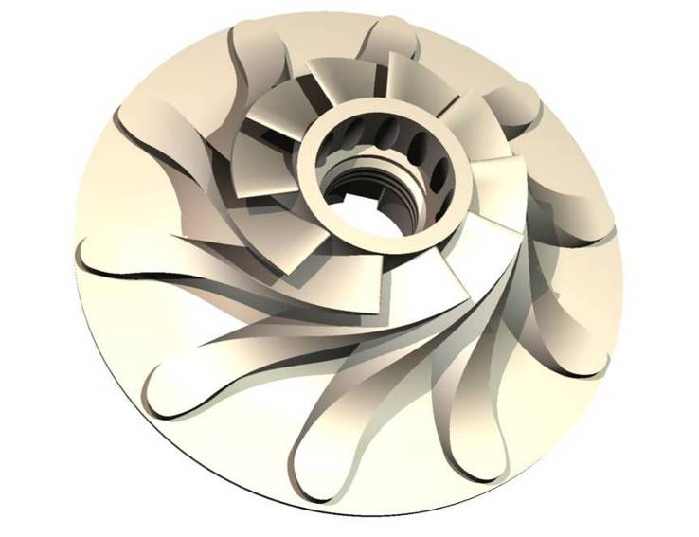
IMPELLER, 3D GEOMETRY OF VANES
Notes:
Титул

Slide 52
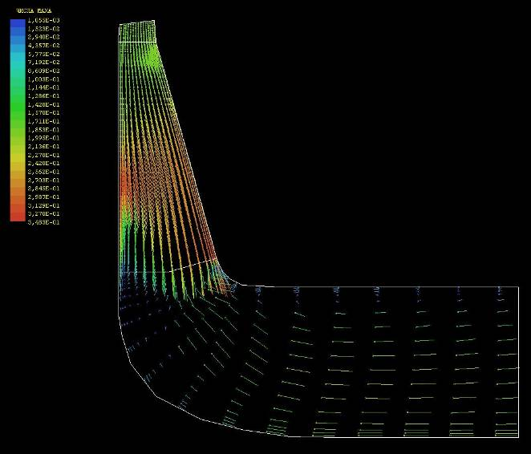
IMPELLER,
3D MODEL OF FLOW IN CHANNELS (FIELD OF VELOCITIES)
Notes:
Титул

Slide 53
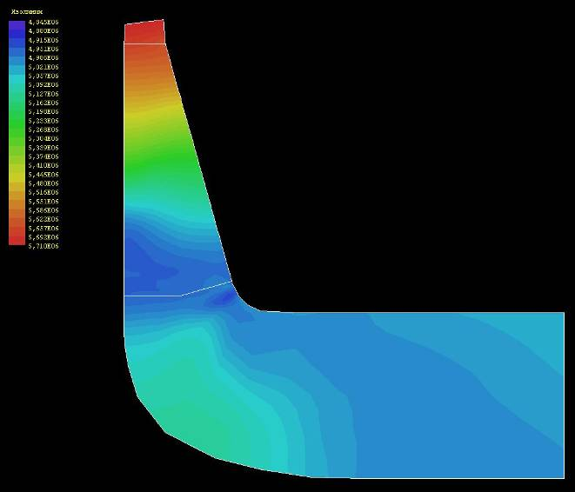
IMPELLER,
3D MODEL OF FLOW IN CHANNELS (FIELD OF PRESSURES)
Notes:
Титул

Slide 54
Diagram of 1kW estimated cost
dependence on UTDU power
Notes:
Титул

Slide 55
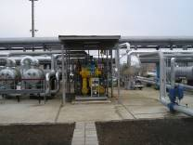
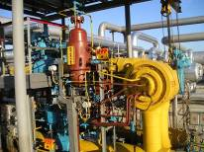
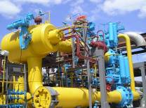
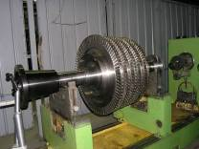
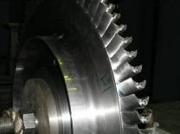
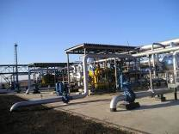
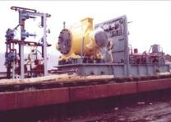
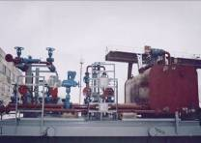

ENERGY-SAVING TURBOEXPANDERS (UTDU)
Notes:
Завершающий

